Slide 1

Five forces analysis
The threat of entry :market leader + high entry barrier =>relatively immune to the threat of new entrants.
The power of buyers: no switching costs=> High buyer power
The power of suppliers: directly from producing countries: Latin America (50%), Pacific Rim (35%) and East Africa (15%) + fixed-price and price-to-be-fixed supply chain =>certain level of power against suppliers.
The threat of substitutes: cheaper coffee + ‘coffee-at-home’ maker machines + instant/homemade (caffeinated) drinks =>great substitute challenges
Competitive rivalry: catering establishments + small stores and imitators + other premium coffee providers => intense competition
Thoughts: strategies for raising customer loyalty and attracting potential customers

Slide 2
Competitor analysis
Mcdonald’s or similar catering establishments
Illy or similar premium coffee provider
Calibou or similar specialty coffee store
Nestle or similar instant coffee and coffee machine supplier
The arrows indicates the potential move of these competitors
Product range small-----------------------------------------------------------------→large
Geographical range
Local Calibou↓→
Regional Illy↓ Nestle→↓
Global McDonalds→
Thoughts: Strategies for expansion/globalization and diversification?
Starbucks↓

Slide 3
SWOT analysis
Strength
Market leader
quality and taste
High brand equity
Large scale of operations
Robust financial performance
Weakness
High product price
High operating cost
profits are highly dependent on coffee product
Closed numbers of stores
Weak compliance function
legal proceedings
Opportunities
Entry into Asian market
Market penetration in international countries
New mode of sales like whole bean in supermarkets
Co-branding with other food manufacturers
Threats
Increasing and more intense competition
Variation in coffee prices in developing countries
health conscious trends of customers’ thinking
Labor unions issues
Global cultural difference and community acceptance
Thoughts: Profitability (price, cost and sales), globalization, cultural and political issues, product innovation

Slide 4
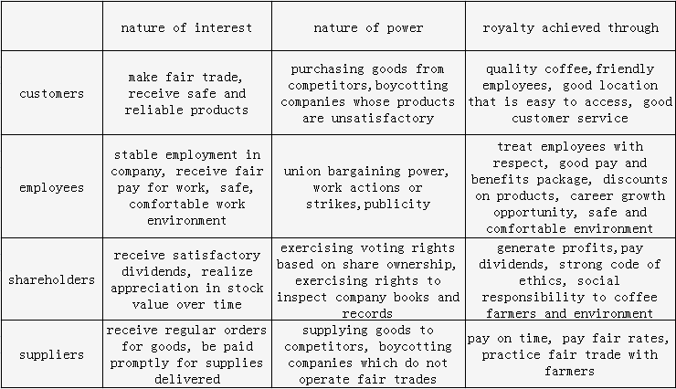
Stakeholder analysis

Slide 5
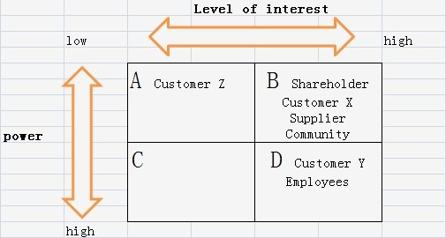
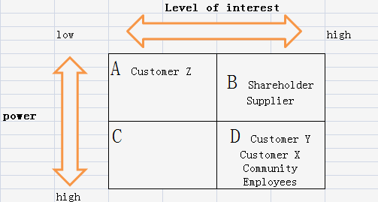
Stakeholder analysis-cont
Customer x: those strongly in favor of the company/product
Customer y: those hostile to the company
Customer z: those don’t care about the company
Thoughts: supplier, customer and employee relations; cultural issues

Slide 6
KSF identification
Suitable choice of store location
Cultural fitting of different markets (taste, environment, life pace, thinking)
Reputation of brand and product introduction of new product
Quality, price and cost balancing
Rising consideration and commitment to environment issues
Employee satisfaction and development
Supplier satisfaction
Customer satisfaction and loyalty
Suitable marketing strategy

Slide 7
Key issues on table
Growth strategy ( expansion, diversification, innovation, penetration)
Cultural and political issues in global market
Quality and profitability
Internal focus
Customer and supplier loyalty
Advertising and marketing

